Slide 1
Online Bus Booking System
Presented By: Abhinav Bhardwaj
Reg. No.: 12200479
Course: B.Tech (CS & AI)
University: DAV University
Year: 2025
1

Slide 2

Introduction to Seamless Travel
The Online Bus Booking System is a modern web-based application meticulously designed to simplify the entire process of searching, selecting, and booking bus tickets. It transforms the user experience from a cumbersome task to an intuitive digital journey.
2

Slide 3
Key Features at a Glance
1
2
3
User Registration & Login
Route & Bus Exploration
Detailed Information
Secure access for personalized booking experiences.
Browse routes, view available buses, and compare options effortlessly.
Access timing, fare, seat availability, and customer ratings for informed decisions.
4
5
Interactive Seat Selection
Secure Payment & E-Ticket
Visually choose preferred seats before booking.
Complete transactions securely and receive downloadable e-tickets.
3

Slide 4
Addressing the Problem: Why We Need This System
Manual Booking Hassles
Traditional methods lead to inconvenience, confusion, and outdated information.
Lack of Transparency
Users struggle to find structured, real-time data on routes, buses, and seat availability.
Operational Inefficiency
Absence of centralized management causes errors in bus schedules and booking records.
Poor User Experience
No proper system for ratings, visual seat selection, or informed decision-making.
4

Slide 5

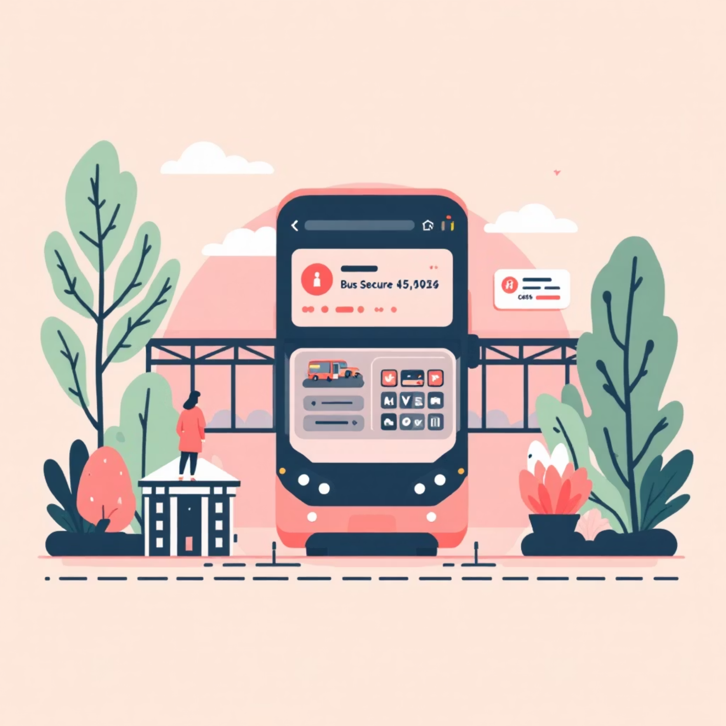
From Outdated to Optimized: The Existing vs. Proposed System
Existing System Challenges
Proposed System Solutions
Reliance on physical counters or limited third-party sources.
Well-structured online platform with secure user authentication.
No centralized database for real-time information.
Interactive seat selection and secure payment gateway.
Inability to check seat availability or select seats visually.
Comprehensive bus details including ratings and e-ticket generation.
Lack of secure logins and rating features.
Admin panel for efficient route, bus, and booking management.
Inefficient admin management of data.
Real-time updates and asset management with Firebase and Cloudinary.
5

Slide 6


Project Description: Dual Role Functionality
User Role
Admin Role
Register/Login
Admin Login
Browse routes & buses
Manage routes (add, edit, delete)
View details, ratings, and fares
Add & update bus details
Select seats & book
Monitor user bookings
Make secure payments
View & download e-ticket
This system ensures a highly responsive, secure, and user-friendly experience for travelers, while empowering administrators with comprehensive control.
6

Slide 7
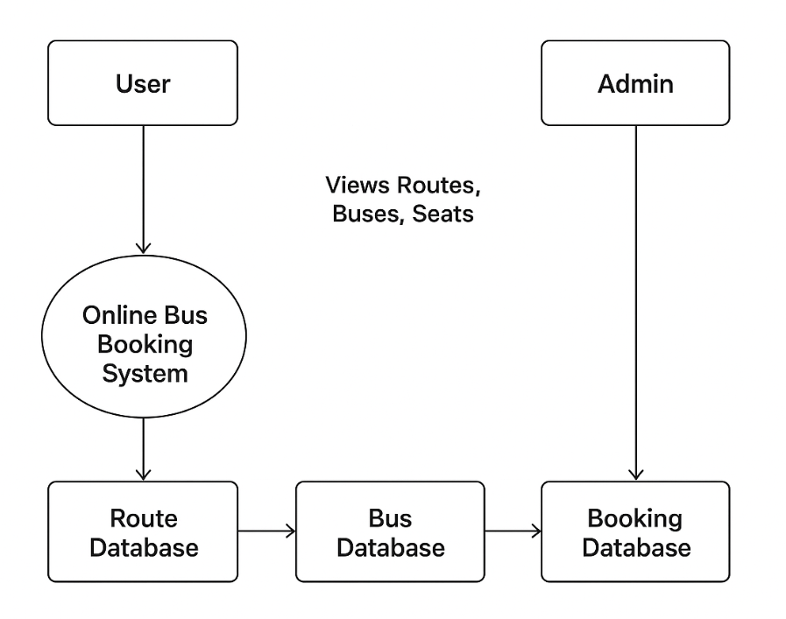
DFD Level 0
7

Slide 8








System Modules: Breaking Down the Architecture
Admin Modules
User Modules
Admin Login
Signup / Login
Add/Manage Route
View Routes/Buses
Add/Manage Bus
Rate Buses
View User Bookings
Select Seats
Booking & Payment
View Ticket
8

Slide 9
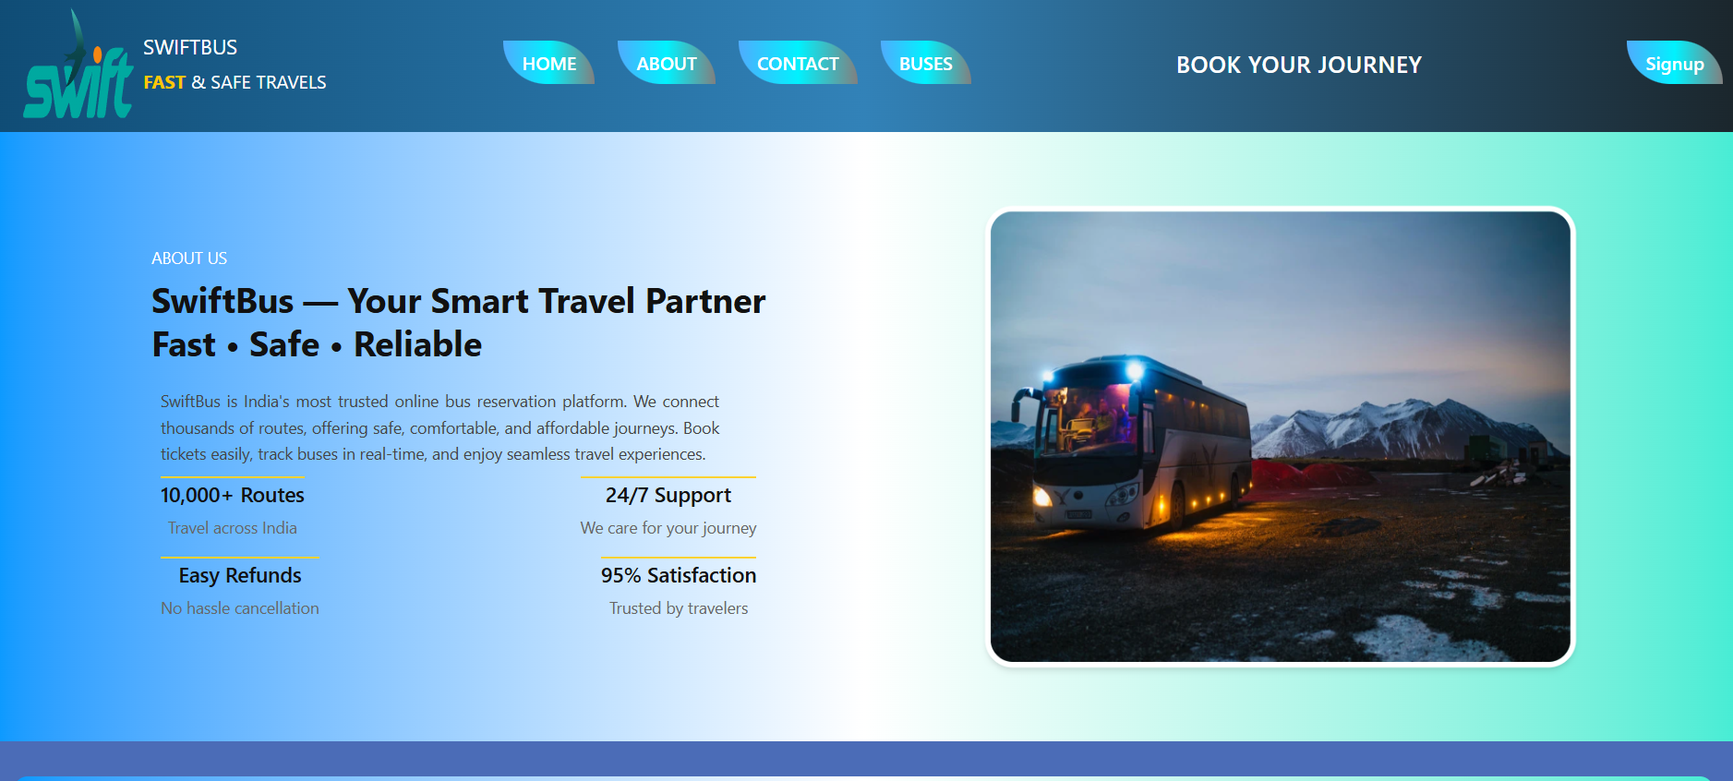
ScreenShots Of User Pannel
9

Slide 10
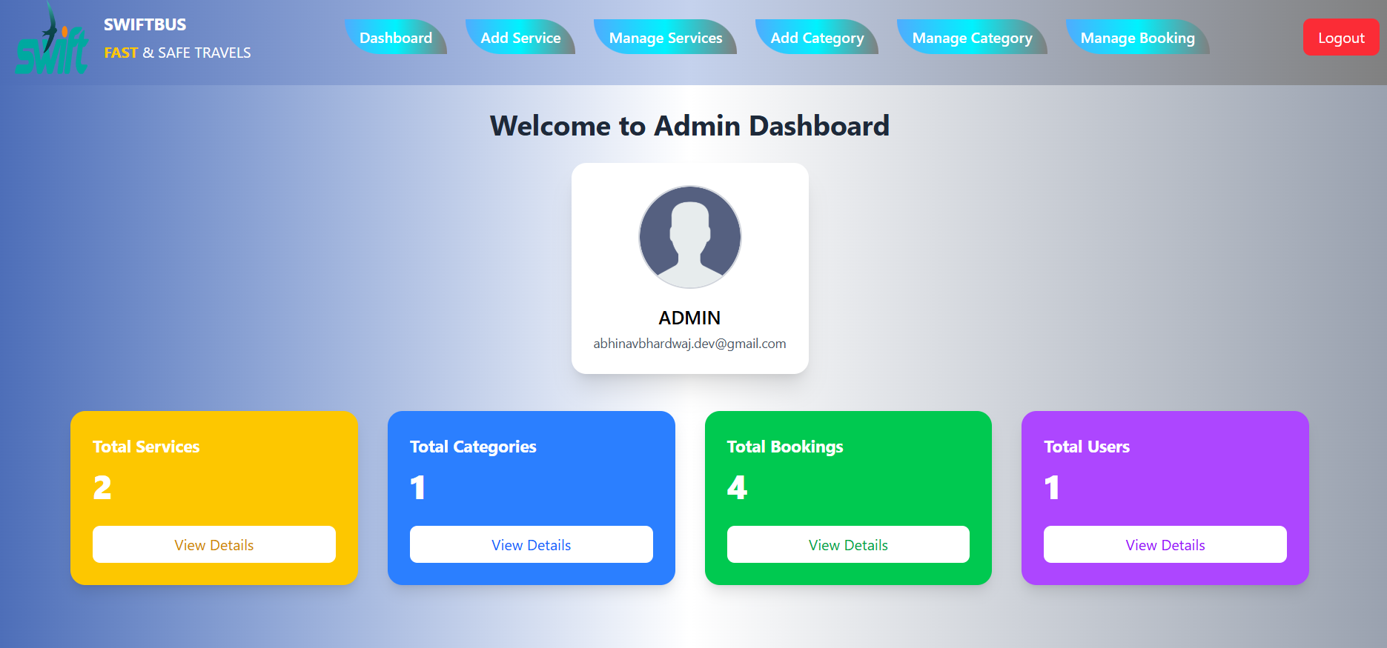
ScreenShots Of Admin Pannel
10

Slide 11




Powering the Platform: Technologies Used
React + Vite
Tailwind CSS
Modern JavaScript library for building responsive user interfaces.
Utility-first CSS framework for rapid and custom UI development.
Firebase
Cloudinary
For secure authentication and real-time database management.
Cloud-based image and video management for efficient asset hosting.
11

Slide 12
Future Innovations: Expanding Horizons
The Online Bus Booking System is built with scalability in mind, offering numerous avenues for future enhancements to further enrich the user experience and operational efficiency.
AI Bus Suggestions
Personalized recommendations based on travel history.
Mobile Application
Dedicated native apps for Android and iOS users.
Real-time GPS Tracking
Live bus location and estimated arrival times.
Cancellation & Refunds
Integrated online system for ticket changes and refunds.
Multilingual Interface
Wider accessibility for diverse user bases.
UPI & Wallet Integration
Broader payment options for convenience.
Automated Notifications
Departure alerts and booking updates via SMS/email.
12

Slide 13


Conclusion: A Modern Solution for Bus Travel
The Online Bus Booking System stands as a robust and efficient platform designed to revolutionize how users book bus tickets. By offering intuitive features like route selection, bus ratings, interactive seat selection, secure online payment, and instant ticket generation, it significantly elevates the entire travel booking experience.
The dedicated admin panel ensures streamlined management of buses, routes, and user bookings, fostering operational excellence. Leveraging cutting-edge technologies such as React, Firebase, and Cloudinary, the system delivers a secure, scalable, and highly responsive solution. This project not only addresses current market needs but also lays a strong foundation for future advancements, positioning it as an invaluable tool for both travelers and bus operators alike.
Key Takeaway: The Online Bus Booking System offers a seamless, secure, and scalable solution for modern bus travel, with strong potential for continuous innovation.
13

Slide 14
Thank You!
Thank you for reviewing my Online Bus Booking System project. Your guidance and feedback have been extremely valuable in helping me improve my skills and understand practical software development concepts more deeply.
This project has helped me learn how modern web applications are built and how technologies like React, Firebase, and real-time databases can be used to create fast, user-friendly, and secure booking systems.
I believe this platform can offer users a simple, efficient, and reliable way to search buses, check seat availability, make bookings, and manage their travel plans with ease.
14

